Slide 1
Quantum Dynamical Hamiltonian Monte Carlo Owen Lockwood, Peter Weiss, Filip Aronshtein, and Guillaume Verdon
DEPARTMENT OF MATHEMATICAL SCIENCES | 10/09/24
Jack Mandell

Slide 2

Outline of Paper/Presentation
Background
Quantum Dynamical Hamiltonian Monte Carlo Algorithm
Simulations and Experiments
Discussion and Conclusion

Slide 3
Outline of Paper/Presentation
Background
Quantum Dynamical Hamiltonian Monte Carlo Algorithm
Simulations and Experiments
Discussion and Conclusion

Slide 4
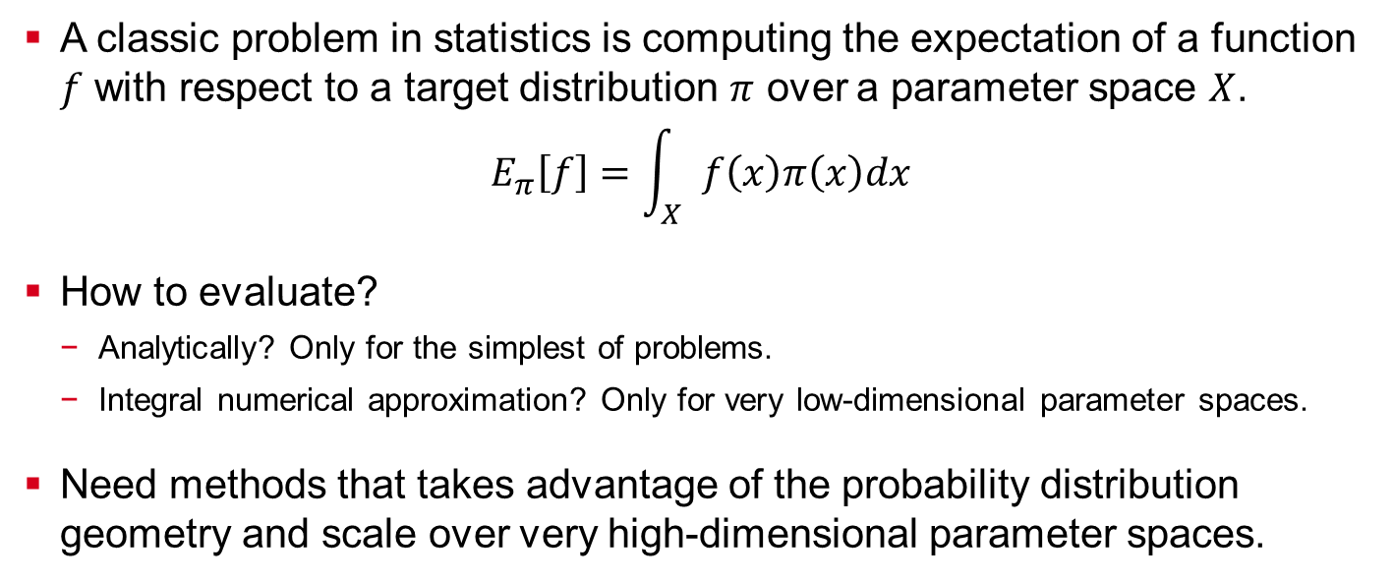
The Big Picture Problem
A classic problem in statistics is computing the expectation of a function $f$ with respect to a target distribution $π$ over a parameter space $X$.
$$E_{π}\left[f\right]=\int_{X}{f\left(x\right)π\left(x\right)dx}$$
How to evaluate?
Analytically? Only for the simplest of problems.
Integral numerical approximation? Only for very low-dimensional parameter spaces.
Need methods that takes advantage of the probability distribution geometry and scale over very high-dimensional parameter spaces.

Slide 5
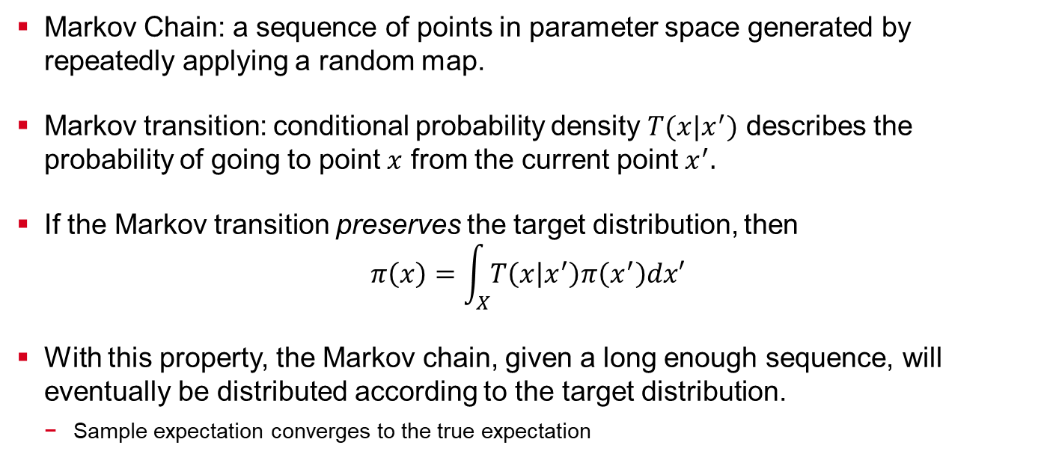
Markov Chain Monte Carlo (MCMC) Sampling Algorithms
Markov Chain: a sequence of points in parameter space generated by repeatedly applying a random map.
Markov transition: conditional probability density $T(x|x^{′})$ describes the probability of going to point $x$ from the current point $x^{′}.$
If the Markov transition preserves the target distribution, then
$$π\left(x\right)=\int_{X}{T\left(x | x^{′}\right)π\left(x^{′}\right)dx′}$$
With this property, the Markov chain, given a long enough sequence, will eventually be distributed according to the target distribution.
Sample expectation converges to the true expectation

Slide 6
MCMC Issues
Asymptotic behavior
How long is long enough to ensure sufficient exploration?
Not generalizable
Need a different Markov transition for every possible probability density?
How to find one that preserves the density?
High autocorrelation
New samples are highly correlated with most recent samples.
Need a robust algorithm that can work with many different densities and chosen Markov transitions (even non-preserving ones).
Metropolis-Hastings MCMC Algorithm

Slide 7
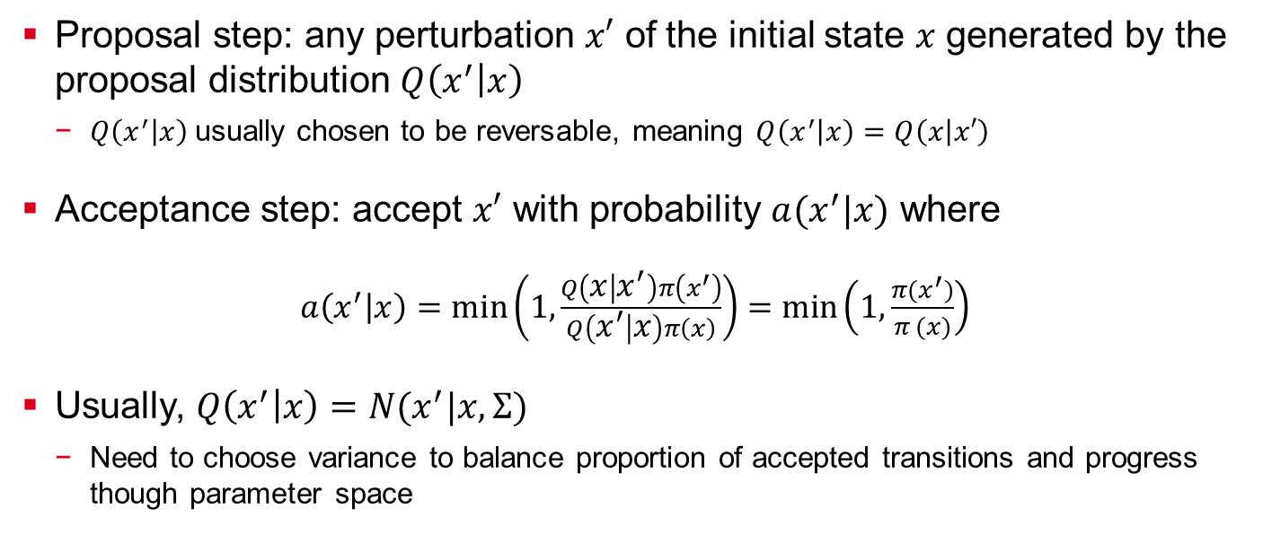
Metropolis-Hastings MCMC Algorithm
Proposal step: any perturbation $x′$ of the initial state $x$ generated by the proposal distribution $Q\left(x^{′} | x\right)$
$Q\left(x^{′} | x\right)$usually chosen to be reversable, meaning $Q\left(x^{′} | x\right)=Q\left(x | x′\right)$
Acceptance step: accept $x′$ with probability $a(x^{′}|x)$ where
$a\left(x^{′} | x\right)=\min\left(1,\frac{Q\left(x | x^{′}\right)π\left(x^{′}\right)}{Q\left(x^{′} | x\right)π\left(x\right)}\right)=$ $min\left(1,\frac{π(x^{′})}{π (x)}\right)$
Usually, $Q\left(x^{′} | x\right)=N(x^{′}|x,Σ)$
Need to choose variance to balance proportion of accepted transitions and progress though parameter space

Slide 8
Issues with Metropolis-Hastings MCMC Algorithm
Exhibits random walk behavior, and scales poorly with larger dimensional parameter spaces
Intuition: exponential number of directions to choose proposal point from, but only a small number of directions stay within the region of high probability and are accepted
Idea: take advantage of the geometry of the probability density
Method: Hamiltonian Monte Carlo Algorithm

Slide 9
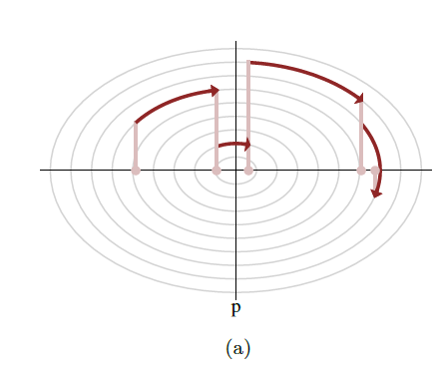
Hamiltonian Monte Carlo at a High Level
Instead of taking random jumps through parameter space, follow the contours of high probability density for some small distance to generate a new sample point
Outline of Algorithm
Lift the initial point into parameter-momentum (phase) space by giving the point a chosen momentum
Solve Hamilton's equations for some time to determine the next point in phase space
Project the point back onto parameter space and use Metropolis-Hasting step for acceptance
p
x

Slide 10
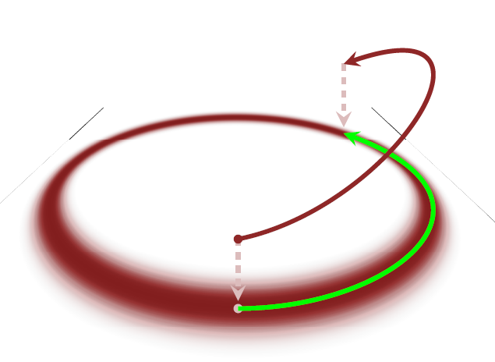
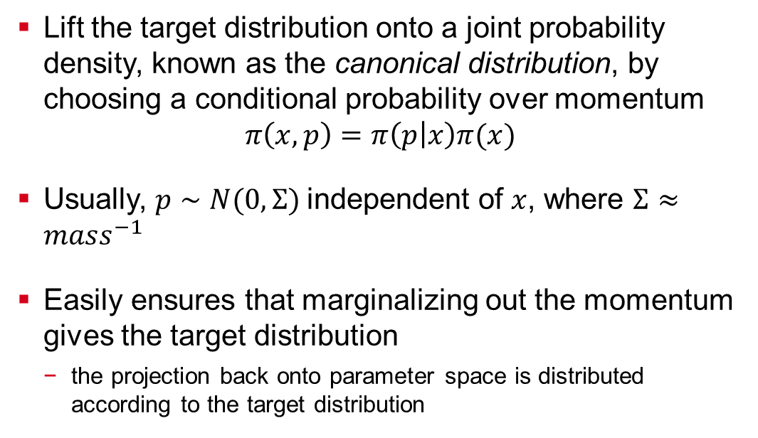
Phase Space
Lift the target distribution onto a joint probability density, known as the canonical distribution, by choosing a conditional probability over momentum
$$π\left(x,p\right)=π\left(p | x\right)π(x)$$
Usually, $p∼N(0,Σ)$independent of $x$, where $Σ≈mass^{−1}$
Easily ensures that marginalizing out the momentum gives the target distribution
the projection back onto parameter space is distributed according to the target distribution

Slide 11
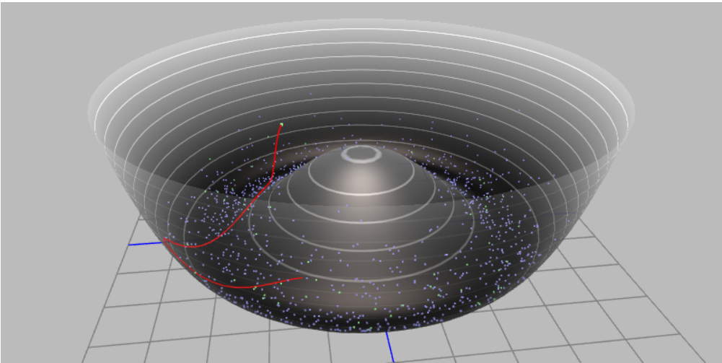
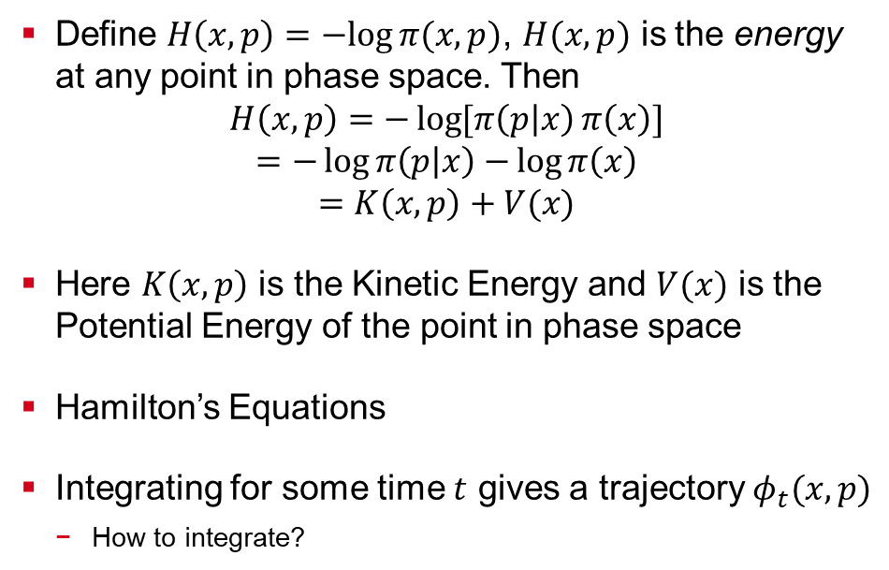
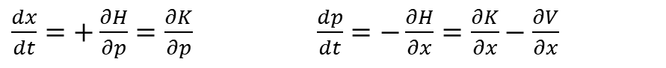
Hamilton’s Equations
Define $H\left(x,p\right)=−log⁡π(x,p)$, $H(x,p)$ is the energy at any point in phase space. Then
$$H\left(x,p\right)=−\log{[π\left(p | x\right)}π\left(x\right)]$$
$$=−\log{π\left(p | x\right)−}\log{π\left(x\right)}$$
$$=K\left(x,p\right)+V(x)$$
Here $K\left(x,p\right)$ is the Kinetic Energy and $V(x)$ is the Potential Energy of the point in phase space
Hamilton’s Equations
Integrating for some time $t$ gives a trajectory $φ_{t}(x,p)$
How to integrate?
$\frac{dx}{dt}=+\frac{∂H}{∂p}=\frac{∂K}{∂p}$ $\frac{dp}{dt}=−\frac{∂H}{∂x}=\frac{∂K}{∂x}−\frac{∂V}{∂x}$

Slide 12
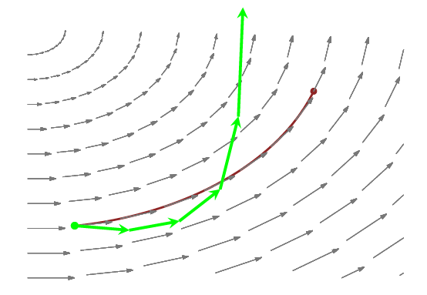
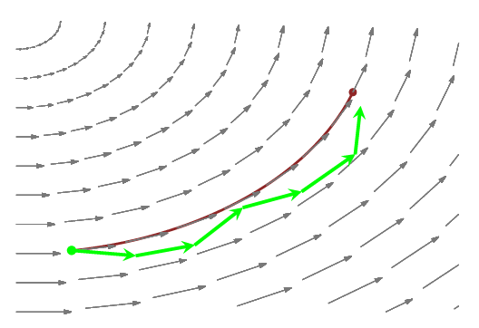
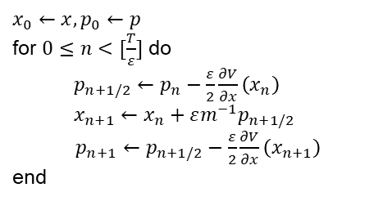
Symplectic integrators
Hamilton equations are solved using symplectic integrators, which preserve phase space volume
Instead of drifting away from an energy level, it oscillates around the energy level even for a long integration time
If the probability distribution over momentum is independent of position, the simple leapfrog integrator is used
$$x_{0}←x,p_{0}←p$$
for $0≤n<[\frac{T}{ε}]$ do
$p_{n+1/2}←p_{n}−\frac{ε}{2}\frac{∂V}{∂x}\left(x_{n}\right)$ $x_{n+1}←x_{n}+εm^{−1}p_{n+1/2}$
$p_{n+1}←p_{n+1/2}−\frac{ε}{2}\frac{∂V}{∂x}\left(x_{n+1}\right)$
end
typical drift
oscillation

Slide 13
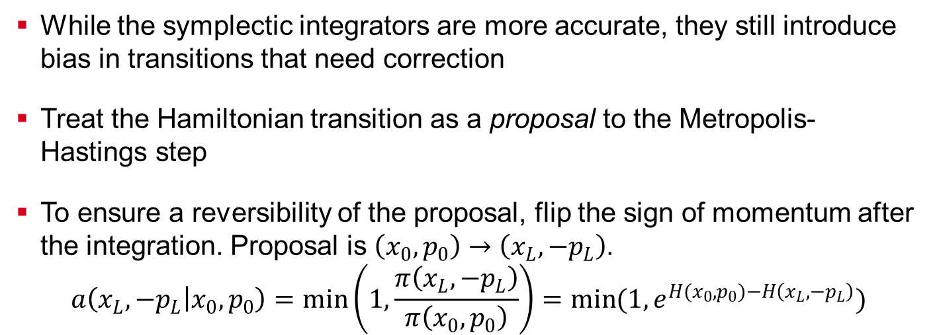
Metropolis-Hastings Step
While the symplectic integrators are more accurate, they still introduce bias in transitions that need correction
Treat the Hamiltonian transition as a proposal to the Metropolis-Hastings step
To ensure a reversibility of the proposal, flip the sign of momentum after the integration. Proposal is $\left(x_{0},p_{0}\right)→\left(x_{L},−p_{L}\right)$.
$$a\left(x_{L},−p_{L} | x_{0},p_{0}\right)=\min\left(1,\frac{π\left(x_{L},−p_{L}\right)}{π\left(x_{0},p_{0}\right)}\right)=\min{(1,e^{H(x_{0},p_{0})−H\left(x_{L},−p_{L}\right)})}$$

Slide 14
Outline of Paper/Presentation
Background
Quantum Dynamical Hamiltonian Monte Carlo Algorithm
Simulations and Experiments
Discussion and Conclusion

Slide 15
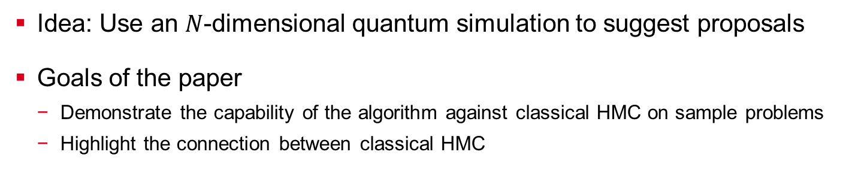
Quantum Dynamical Hamiltonian Monte Carlo Algorithm at a High Level
Idea: Use an $N$-dimensional quantum simulation to suggest proposals
Goals of the paper
Demonstrate the capability of the algorithm against classical HMC on sample problems
Highlight the connection between classical HMC

Slide 16
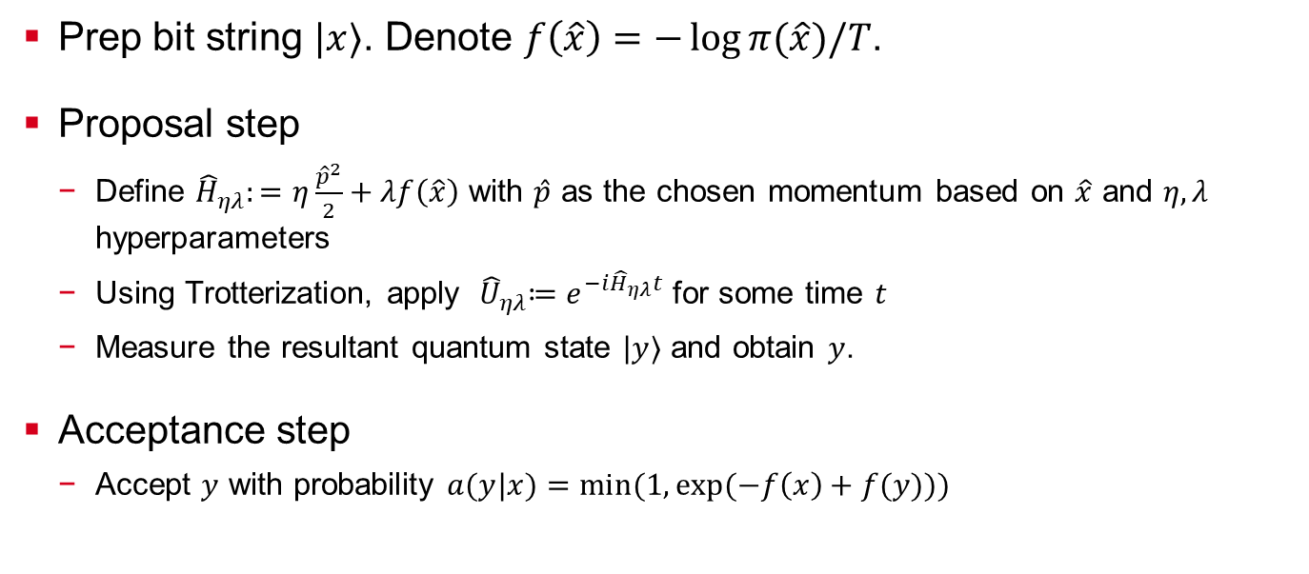
QD-HMC Algorithm
Prep bit string $|x⟩$. Denote $f\left(\hat{x}\right)=−\log{π(\hat{x})/T}$.
Proposal step
Define ${\hat{H}}_{ηλ}:=η\frac{{\hat{p}}^{2}}{2}+λf\left(\hat{x}\right)$ with $\hat{p}$ as the chosen momentum based on $\hat{x}$ and $η,λ$ hyperparameters
Using Trotterization, apply ${ \hat{U}}_{ηλ}≔e^{−i{\hat{H}}_{ηλ}t}$ for some time $t$
Measure the resultant quantum state $|y⟩$ and obtain $y$.
Acceptance step
Accept $y$ with probability $a(y|x)$ $=\min{(1,\exp{(−f\left(x\right)+f(y))})}$

Slide 17
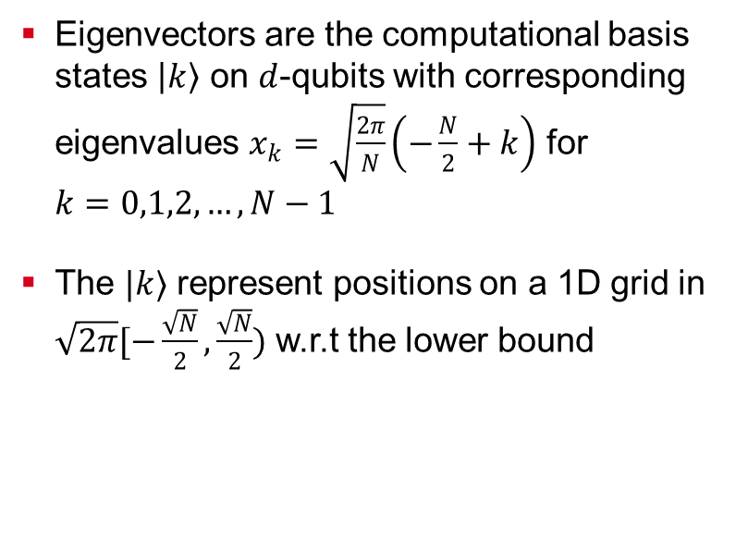
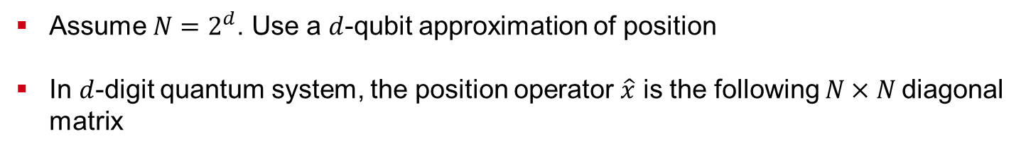
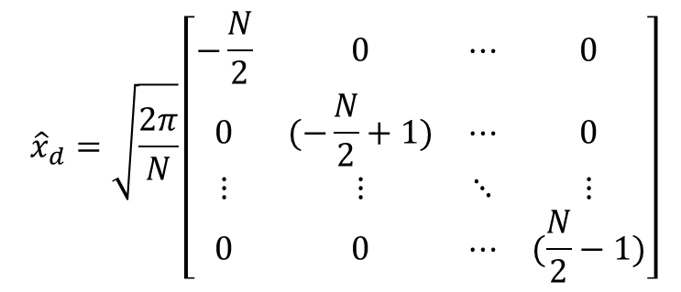
Position Operator
Assume $N=2^{d}$. Use a $d$-qubit approximation of position
In $d$-digit quantum system, the position operator $\hat{x}$ is the following $N×N$diagonal matrix
Eigenvectors are the computational basis states $\left|k\right\rangle$ on $d$-qubits with corresponding eigenvalues $x_{k}=\sqrt{\frac{2π}{N}}\left(−\frac{N}{2}+k\right)$ for $k=0,1,2,…,N−1$
The $|k⟩$ represent positions on a 1D grid in $\sqrt{2π}[−\frac{\sqrt{N}}{2},\frac{\sqrt{N}}{2})$ w.r.t the lower bound
$${\hat{x}}_{d}=\sqrt{\frac{2π}{N}}\left[\begin{matrix}−\frac{N}{2} & 0 & ⋯ & 0 \\ 0 & (−\frac{N}{2}+1) & ⋯ & 0 \\ ⋮ & ⋮ & ⋱ & ⋮ \\ 0 & 0 & ⋯ & (\frac{N}{2}−1)\end{matrix}\right]$$
Notes:
[49]

Slide 18
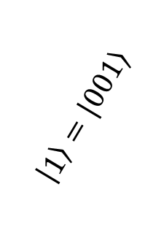

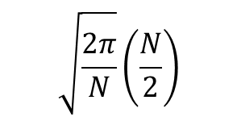
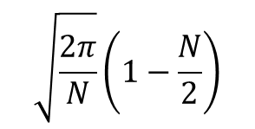
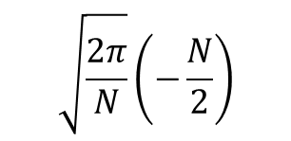
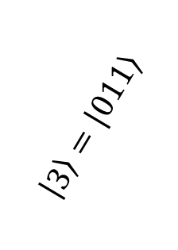
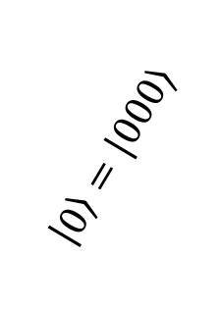
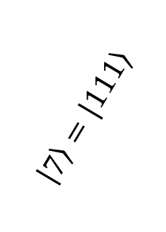
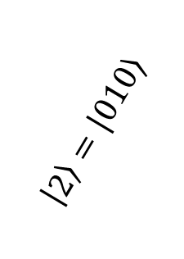
Position Operator Example
Let $d =3$, so $N=2^{3}=8$
…
Eigenvectors
$$\left|0\right\rangle =|000⟩$$
$$\left|3\right\rangle =|011⟩$$
$$\left|7\right\rangle =|111⟩$$
$$\left|2\right\rangle =|010⟩$$
$$\left|1\right\rangle =|001⟩$$
…
[
)
Eigenvalues
$$\sqrt{\frac{2π}{N}}\left(−\frac{N}{2}\right)$$
$$\sqrt{\frac{2π}{N}}\left(1−\frac{N}{2}\right)$$
$$\sqrt{\frac{2π}{N}}\left(\frac{N}{2}\right)$$

Slide 19
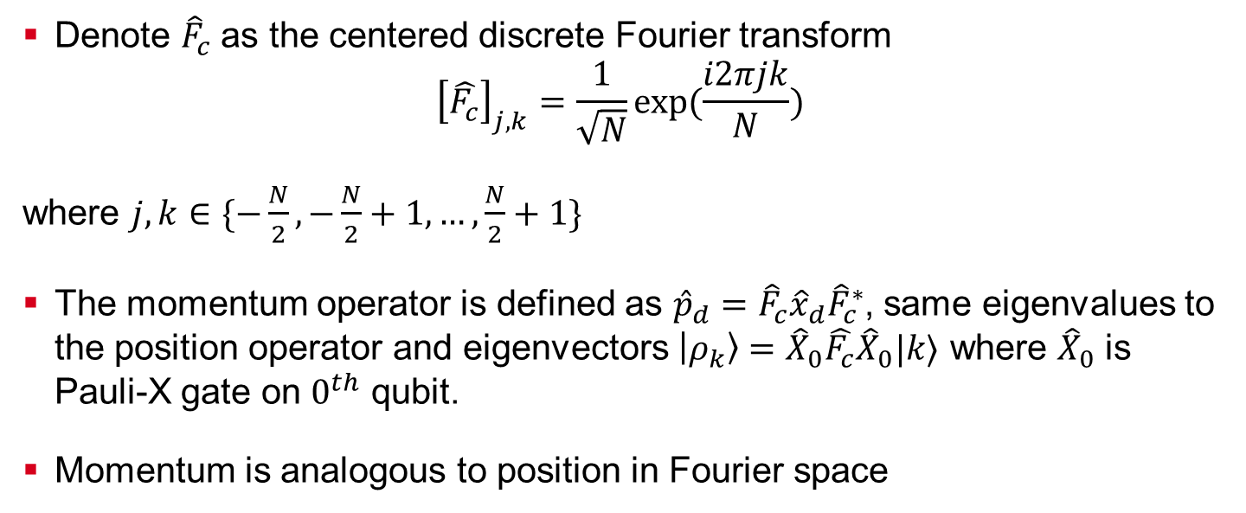
Momentum Operator
Denote ${\hat{F}}_{c}$ as the centered discrete Fourier transform
$${\left[\hat{F_{c}}\right]}_{j,k}=\frac{1}{\sqrt{N}}\exp{(\frac{i2πjk}{N})}$$
where $j,k∈\{−\frac{N}{2},−\frac{N}{2}+1,…,\frac{N}{2}+1\}$
The momentum operator is defined as ${\hat{p}}_{d}={\hat{F}}_{c}{\hat{x}}_{d}{\hat{F}}_{c}^{∗}$, same eigenvalues to the position operator and eigenvectors $\left|ρ_{k}\right\rangle ={\hat{X}}_{0}\hat{F_{c}}{\hat{X}}_{0}|k⟩$ where ${\hat{X}}_{0}$ is Pauli-X gate on $0^{th}$ qubit.
Momentum is analogous to position in Fourier space

Slide 20

Trotterization Overview
Need to compute ${\left|ψ\left(t\right)\right\rangle = \hat{U}}_{ηλ} \left|ψ\left(0\right)\right\rangle$
Trotterization: sequentially apply simpler operators to simulate time evolution of the quantum state
If ${\hat{H}}_{ηλ}={\hat{H}}_{1}+{\hat{H}}_{2}$, then
$${{ \hat{U}}_{ηλ}=e}^{−i\left({\hat{H}}_{1}+{\hat{H}}_{2}\right)t}≈e^{−i{\hat{H}}_{1}t }e^{−i{\hat{H}}_{1}t }+𝒪(t^{2})$$
since $\left[{\hat{H}}_{1},{\hat{H}}_{2}\right]≠0$ in general
In this case, ${\hat{H}}_{1}=η\frac{{\hat{p}}^{2}}{2}$ and ${\hat{H}}_{2}=λf\left(\hat{x}\right)$

Slide 21
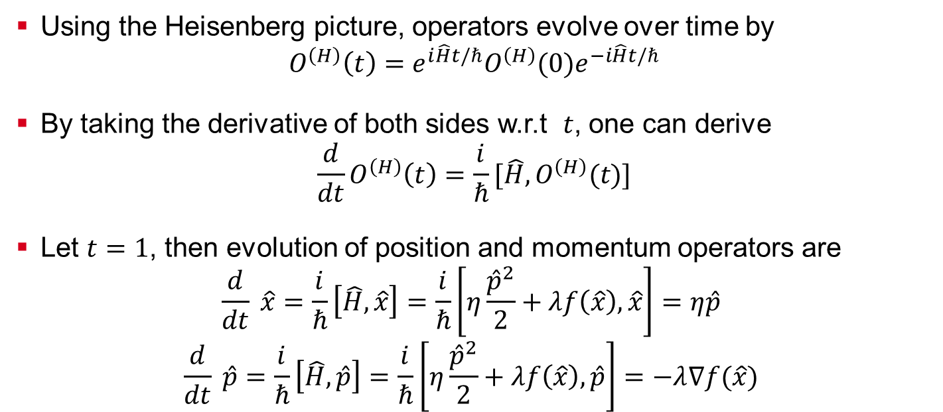
How Trotterization updates the Hamiltonian
Using the Heisenberg picture, operators evolve over time by
$$O^{\left(H\right)}\left(t\right)=e^{i\hat{H}t/ℏ}O^{\left(H\right)}(0)e^{−i\hat{H}t/ℏ}$$
By taking the derivative of both sides w.r.t $t$, one can derive
$${\frac{d}{dt}O}^{\left(H\right)}\left(t\right)=\frac{i}{ℏ}[\hat{H},O^{\left(H\right)}(t)]$$
Let $t=1$, then evolution of position and momentum operators are
$$\frac{d}{dt} \hat{x}=\frac{i}{ℏ}\left[\hat{H},\hat{x}\right]=\frac{i}{ℏ}\left[η\frac{{\hat{p}}^{2}}{2}+λf\left(\hat{x}\right),\hat{x}\right]=η\hat{p}$$
$$\frac{d}{dt} \hat{p}=\frac{i}{ℏ}\left[\hat{H},\hat{p}\right]=\frac{i}{ℏ}\left[η\frac{{\hat{p}}^{2}}{2}+λf\left(\hat{x}\right),\hat{p}\right]=−λ∇f(\hat{x})$$

Slide 22
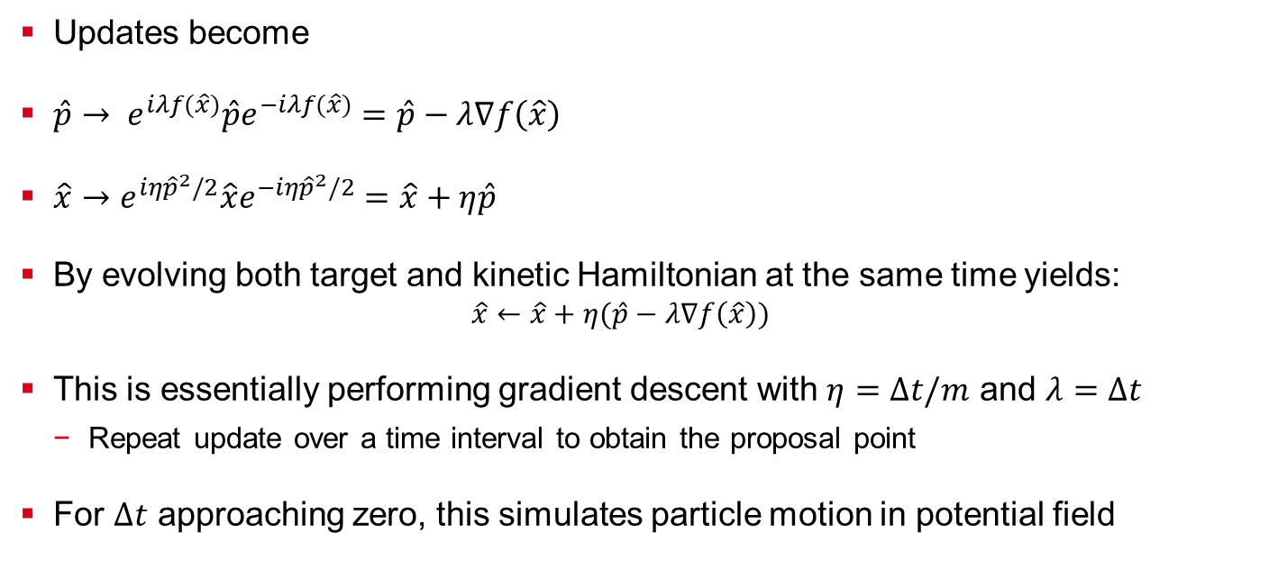
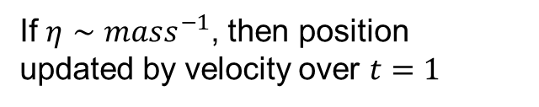
Trotter Updates
Updates become
$\hat{p}→ e^{iλf(\hat{x})}\hat{p}e^{−iλf(\hat{x})}=\hat{p}−λ∇f\left(\hat{x}\right)$
$\hat{x}→e^{iη{\hat{p}}^{2}/2}\hat{x}e^{−iη{\hat{p}}^{2}/2}=\hat{x}+η\hat{p}$
By evolving both target and kinetic Hamiltonian at the same time yields:
$$\hat{x}←\hat{x}+η(\hat{p}−λ∇f\left(\hat{x}\right))$$
This is essentially performing gradient descent with $η=Δt/m$ and $λ=Δt$
Repeat update over a time interval to obtain the proposal point
For $Δt$ approaching zero, this simulates particle motion in potential field
momentum shifted proportional to negative gradient of target function
If $η∼$ $mass^{−1}$, then position updated by velocity over $t=1$

Slide 23
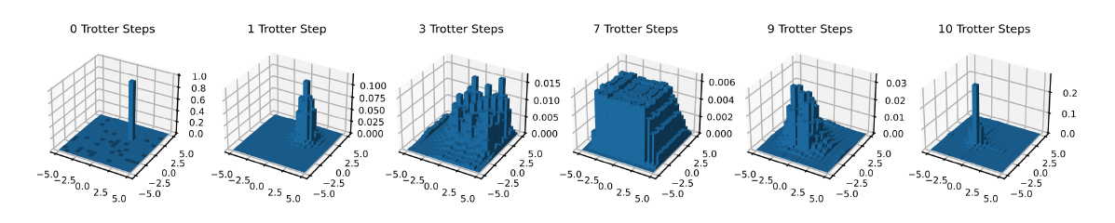

Trotter Steps Example to Generate a Single Proposal
Let the target distribution be a 2D Gaussian with mean $(0,0)$.
Below is the progression over 10 Trotter steps ($t = 2$) of the probability wavefunction
Wavefunction initialed away from (0,0), 100% in the location
Final wavefunction is localized near mean (0,0)

Slide 24
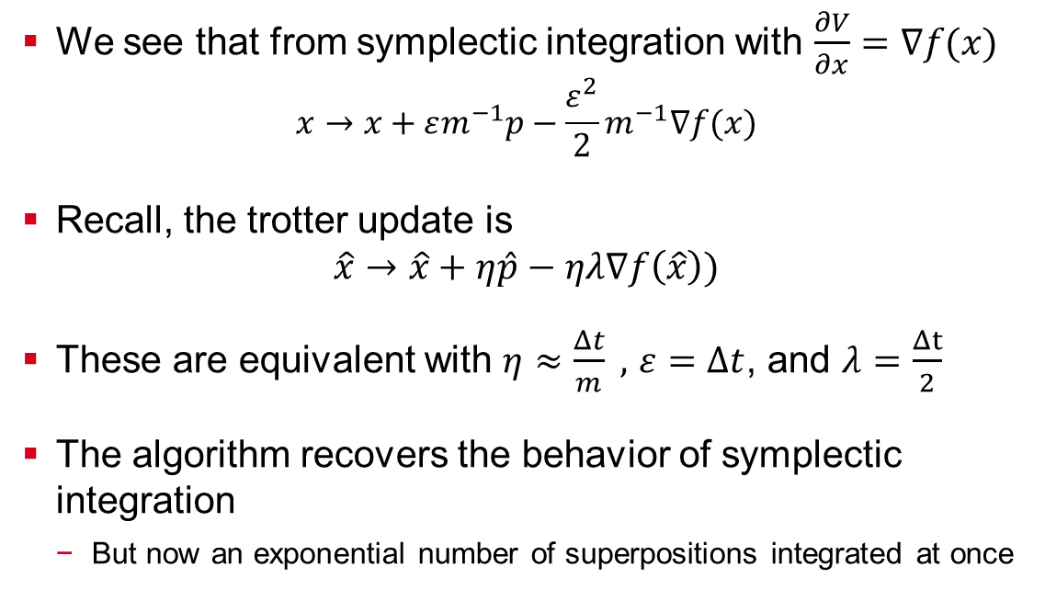
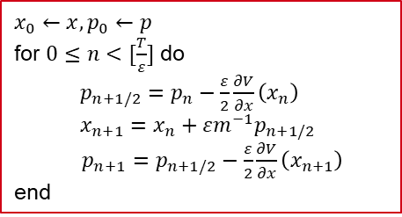
Connection to Leapfrog Integration
We see that from symplectic integration with $\frac{∂V}{∂x}=∇f(x)$
$$x→x+εm^{−1}p−\frac{ε^{2}}{2}m^{−1}∇f(x)$$
Recall, the trotter update is
$$\hat{x}→\hat{x}+η\hat{p}−ηλ∇f\left(\hat{x}\right))$$
These are equivalent with $η≈\frac{Δt}{m} ,$ $ε=Δt$, and $λ=\frac{Δt}{2}$
The algorithm recovers the behavior of symplectic integration
But now an exponential number of superpositions integrated at once
$$x_{0}←x,p_{0}←p$$
for $0≤n<[\frac{T}{ε}]$ do
$p_{n+1/2}=p_{n}−\frac{ε}{2}\frac{∂V}{∂x}\left(x_{n}\right)$ $x_{n+1}=x_{n}+εm^{−1}p_{n+1/2}$
$p_{n+1}=p_{n+1/2}−\frac{ε}{2}\frac{∂V}{∂x}\left(x_{n+1}\right)$
end
Recall Leapfrog Integration

Slide 25
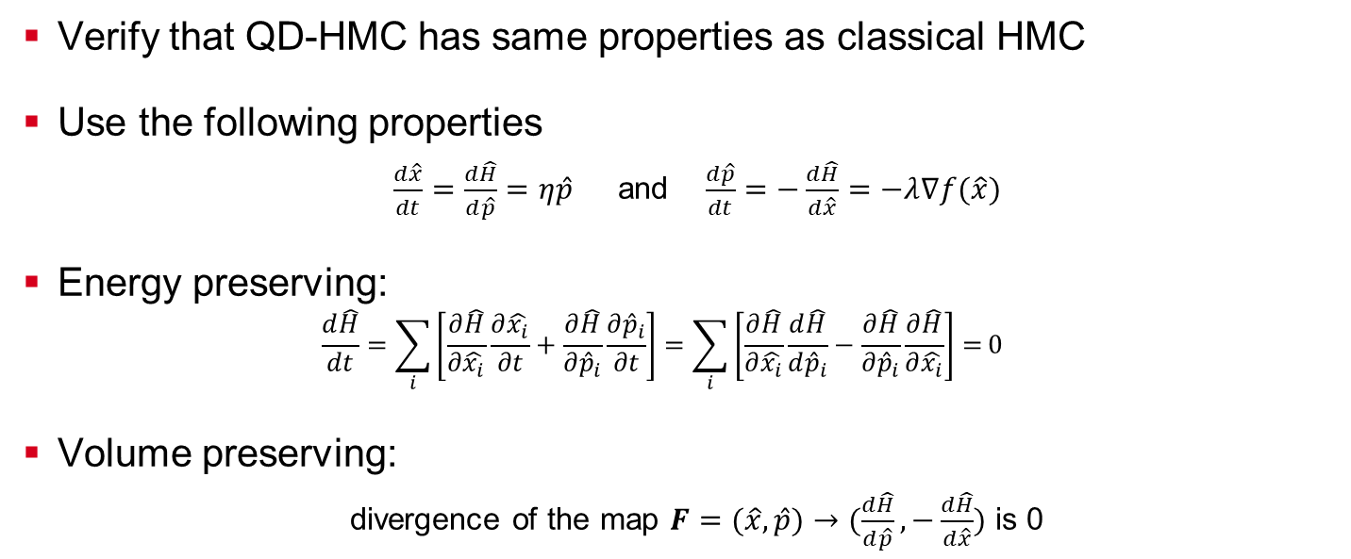
QD-HMC Energy/Volume Conservation
Verify that QD-HMC has same properties as classical HMC
Use the following properties
$\frac{d\hat{x}}{dt}=\frac{d\hat{H}}{d\hat{p}}=η\hat{p}$ and $\frac{d\hat{p}}{dt}=−\frac{d\hat{H}}{d\hat{x}}=−λ∇f(\hat{x})$
Energy preserving:
$$\frac{d\hat{H}}{dt}=\sum_{i}{\left[\frac{∂\hat{H}}{∂\hat{x_{i}}}\frac{∂\hat{x_{i}}}{∂t}+\frac{∂\hat{H}}{∂{\hat{p}}_{i}}\frac{∂{\hat{p}}_{i}}{∂t}\right]=\sum_{i}{\left[\frac{∂\hat{H}}{∂\hat{x_{i}}}\frac{d\hat{H}}{d{\hat{p}}_{i}}−\frac{∂\hat{H}}{∂{\hat{p}}_{i}}\frac{∂\hat{H}}{∂\hat{x_{i}}}\right]=}}0$$
Volume preserving:
divergence of the map $F=(\hat{x},\hat{p})→(\frac{d\hat{H}}{d\hat{p}},−\frac{d\hat{H}}{d\hat{x}})$ is 0

Slide 26
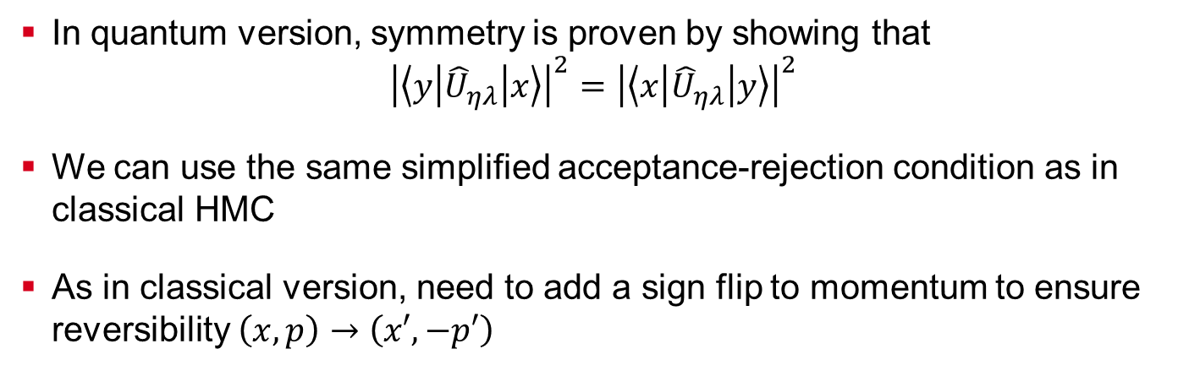
QD-HMC Reversible and Symmetric Proposals
In quantum version, symmetry is proven by showing that
$${\left|\left\langle y\left|{\hat{U}}_{ηλ}\right|x\right\rangle \right|}^{2}={\left|\left\langle x\left|{\hat{U}}_{ηλ}\right|y\right\rangle \right|}^{2}$$
We can use the same simplified acceptance-rejection condition as in classical HMC
As in classical version, need to add a sign flip to momentum to ensure reversibility $\left(x,p\right)→\left(x′,−p′\right)$

Slide 27
Outline of Paper/Presentation
Background
Quantum Dynamical Hamiltonian Monte Carlo Algorithm
Simulations and Experiments
Discussion and Conclusion

Slide 28
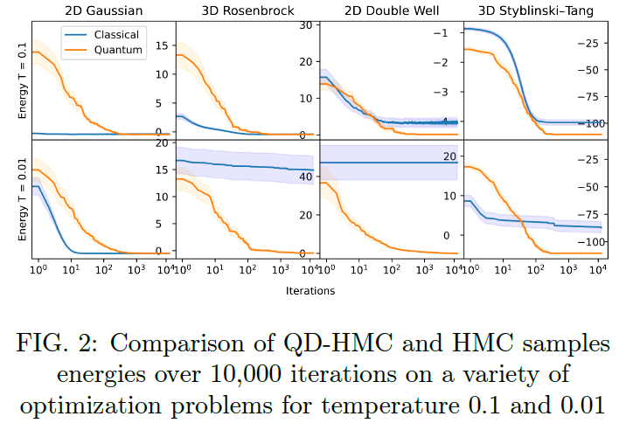
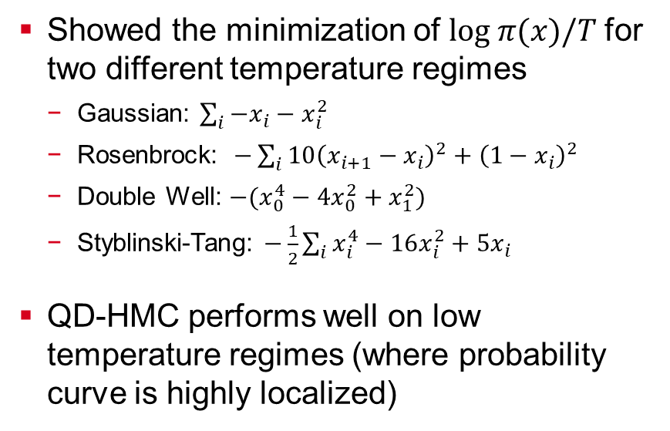
QD-HMC Energy Minimization Convergence Example
Showed the minimization of $log π(x)/T$for two different temperature regimes
Gaussian: $\sum_{i}{−x_{i}−x_{i}^{2}}$
Rosenbrock: $−\sum_{i}{10{\left(x_{i+1}−x_{i}\right)}^{2}+{\left(1−x_{i}\right)}^{2}}$
Double Well: $−(x_{0}^{4}−4x_{0}^{2}+x_{1}^{2})$
Styblinski-Tang: $−\frac{1}{2}\sum_{i}{x_{i}^{4}−16x_{i}^{2}+5x_{i}}$
QD-HMC performs well on low temperature regimes (where probability curve is highly localized)

Slide 29
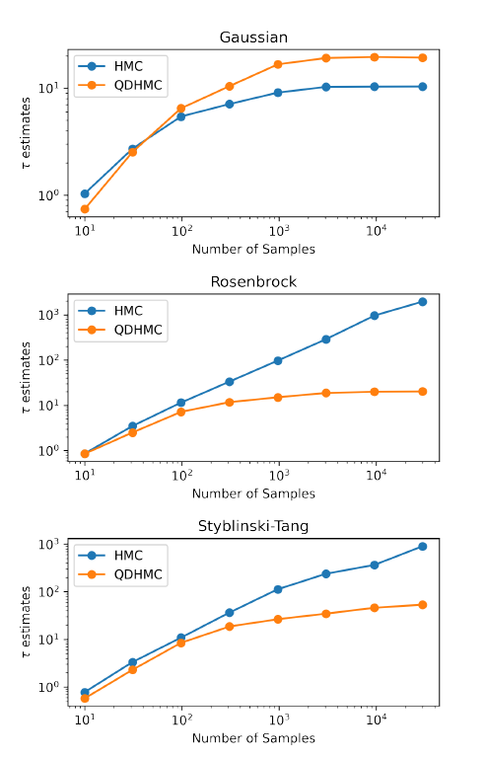
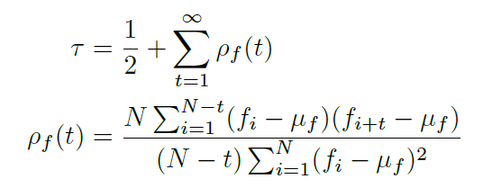
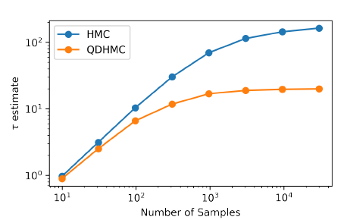

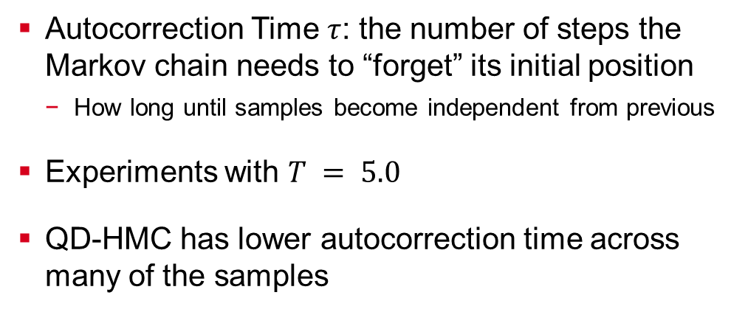
Autocorrection Time Analysis
Autocorrection Time $τ$: the number of steps the Markov chain needs to “forget” its initial position
How long until samples become independent from previous
Experiments with $T = 5.0$
QD-HMC has lower autocorrection time across many of the samples
Double Well
Samples: ${\left\{f_{i}\right\}}_{i=1}^{N}$

Slide 30
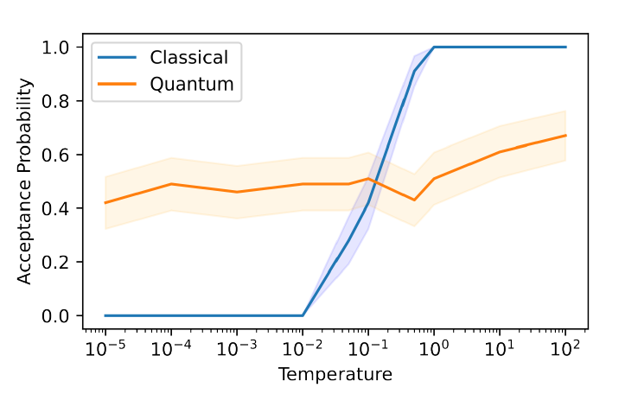
QD-HMC Resilience in Low Temperature Regimes
Plot acceptance probability for proposal functions in classical and QD-HMC for 100 points in each temperature
QD-HMC acceptance probability is 50% regardless of temperature
Classical HMC acceptance probability is highly positively correlated with temperature
2D Double Well

Slide 31
Outline of Paper/Presentation
Background
Quantum Dynamical Hamiltonian Monte Carlo Algorithm
Simulations and Experiments
Discussion and Conclusion

Slide 32
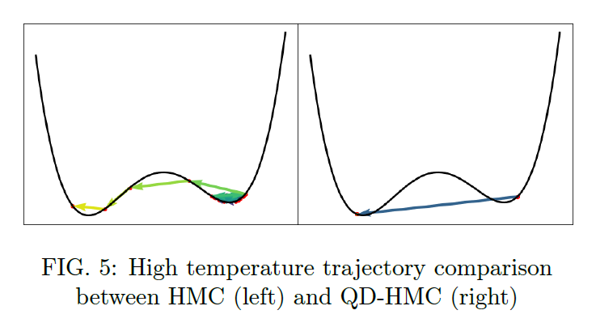
Future Research Areas
Focus attention where QD-HMC has potential for speedup
Potential for polynomial speedup in low temperature regimes
Essentially becomes Grover search with narrow gaussian target state
QD-HMC might not fair well with high temperatures (T = 100)
Step sizes become much larger and can not be overcome by hyperparameter tuning
Further research to see if QD-HMC benefit is mostly in low temperature regimes

Slide 33
References
Michael Betancourt. A Conceptual Introduction to Hamiltonian Monte Carlo
Owen Lockwood et. al. Quantum Dynamical Hamiltonian Monte Carlo
Rolando D. Somma. Quantum Simulations of a One Dimensional Quantum System
D. Coppersmith. An Approximate Fourier Transform Useful in Quantum Factoring
Christopher M. Bishop. Pattern Recognition and Machine Learning

